Slide 1
Stack Architecture
Dr. John P. Abraham
Utrgv

Slide 2
Computer Architecture
Determine what
attributes are important for a new computer
design a computer to maximize
performance while staying within cost, power, and availability constraints
Now do instruction set design (ISA is synonymous with architecture)
Organize components to maximize function
ISA is instructions visible to a programmer

Slide 3
Classes of ISA
Accumulator
Stack
General purpose registers
CISC
RISC
Already discussed Stack. Will discuss RISC extensively later

Slide 4
Stack Architecture
Uses a set of memory words or registers as stack.
It uses a special register called SP (stack pointer) to point to the top of the stack. And a Data register called DR
Operations are push and pop. All pop and push is from the top pointed by SP and what is pushed or popped goes through the register DR.

Slide 5
Stack registers
Additional special flags used are Full and Empty.
In the beginning SP ← 0, Full ← 0, Emty ←1
In in 64 register stack, first element will be stored in register 1 and 64th one will stored in register 0
To push we increment SP by one and place the element in that register. When we get to 63 (111111) add a 1, now all will become 000000
Not discussing pop unless students ask

Slide 6
Stack is well suited for Postfix
Usually we write in infix like this 2+3-1
This needs to be converted to postfix like this 2 3 + 1 –
Push 2 push 3, when it encounters and operand pop two from the stack and do the operation based on the operand. In this case pops 2 and 3 and do a addition. The result is pushed into the stack. The stack now has only 5. Now push 1. Now it encounters an operand which is -.
Now pop two items and perform the operation. Pop 1 and 5. Subtract 1 from 5, the answer is 4.

Slide 7
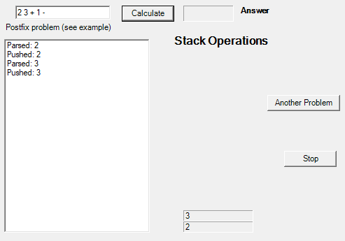
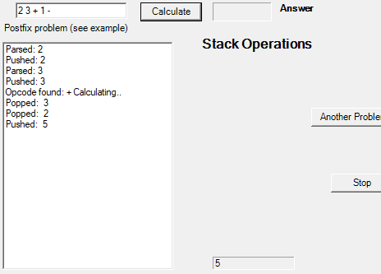
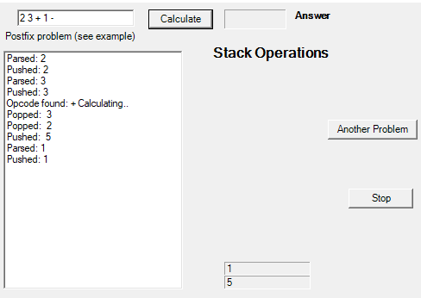
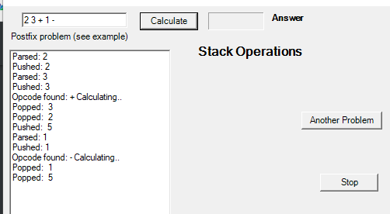

Slide 8
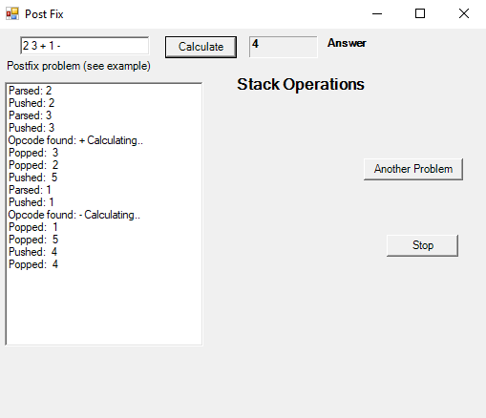

Slide 9
Stack can be set up in any general purpose register CPU
For performing nested subroutines
Recursions
Any last in first out operations

